Slide 1
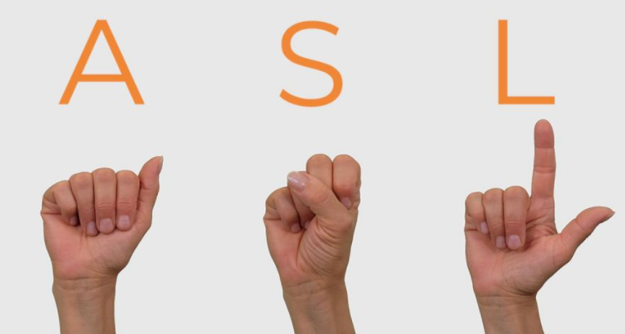
Design of Sign Language Interpreter using Deep Learning and OpenCV
Under the supervision of: Mrs. Kamaldeep Sharma (Assistant Professor at SEEE, LPU)
Capstone Group: EC055 Batch: 2017-2021
Presentation By: Brajesh Kumar (11706496) , Deepti Sehgal (11703036) and Ayan Kaushik (11716863)
School of Electronics and Electrical Engineering,
Lovely Professional University, Phagwara, Punjab, India

Slide 2
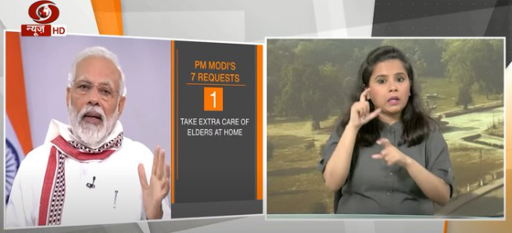
Introduction
Sign languages (also known as signed languages) are languages that use the visual-manual modality to convey meaning.
This language is expressed through manual articulations i.e, hand gestures in combination with non-manual elements like other body parts movement e.g. Face, Shoulders.
Sign languages are full-fledged natural languages with their own grammar and lexicon.
This gesture based communication is primarily used by both speech-impaired and deaf people.
Figure: A women sign language translator interpreting Prime Minister’s address using hand gestures.

Slide 3
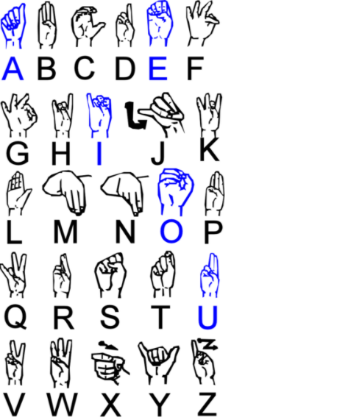
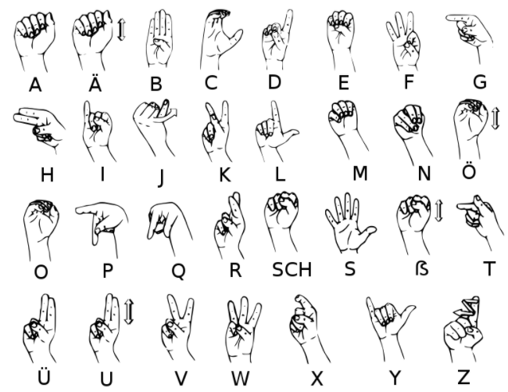
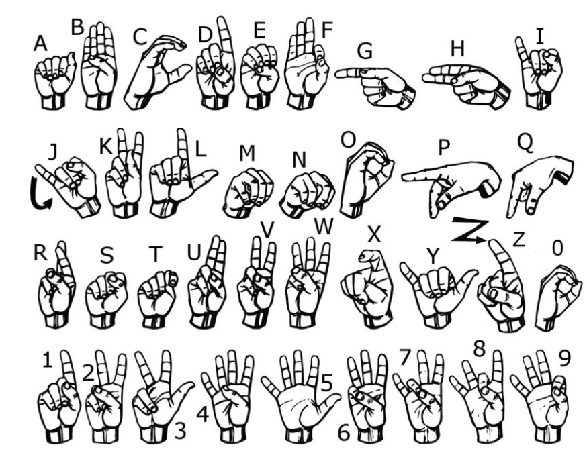
Different Sign Languages
French Sign Language
German Sign Language
American Sign Language
There are lot of other sign languages having variety of lingos.
Different regions have different sign languages.

Slide 4
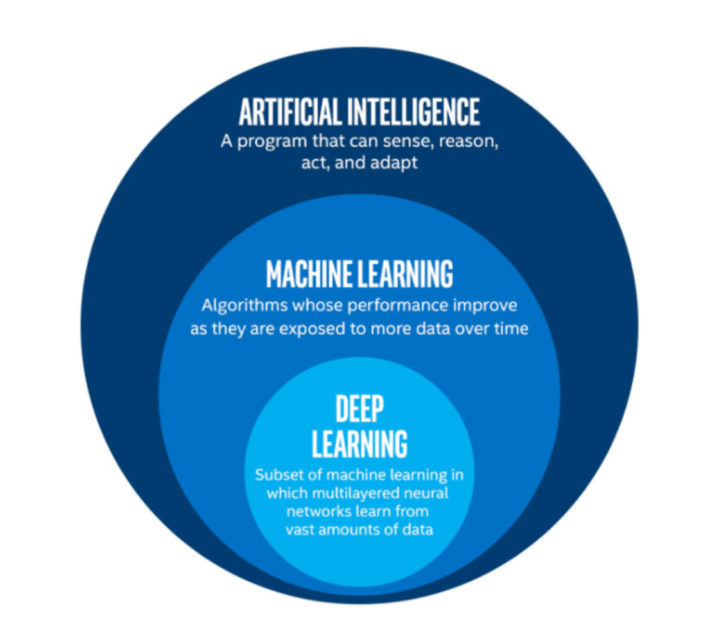
AI Vs ML Vs Deep Learning
Artificial intelligence (AI) is a broad term that refers to methods that enable computers to imitate human behaviour.
All of this is made possible by machine learning (a subset of AI), which is a series of algorithms trained on the data.
Deep learning algorithms analyze data using a predetermined conceptual form in order to draw similar results as humans. Deep learning does this by using a multi-layered system of algorithms known as neural networks.

Slide 5
Aim of the Project
The main aim of our project is to help the those type of people in the society who are speech impaired and hearing impaired (People who can’t listen).
This project tends to decrease the dependency on the translator which acts as a mediator between the normal person and hear or speech impaired person.
The project only requires readily available resources for its implementation, therefore no any matter of cost. For our project we have used our laptop camera as hardware to capture images.

Slide 6




Software and Tools used
Programming Language: Python
Integrated Development Environment (IDE): Microsoft Visual Studio Code
Operating System: Ubuntu 20.04
Virtual Environment to Ubuntu Operating System: Oracle Virtual Box
Python Libraries/Modules Used:
Keras (To implement CNN model)
OpenCV (To access the system’s camera and to capture images and to apply different image processing techniques)
NumPy (To make the array of pixels and further used for their computation)
HunSpell (To implement suggestion feature in the project)
OS (To create directories to store and access the images captured)

Slide 7
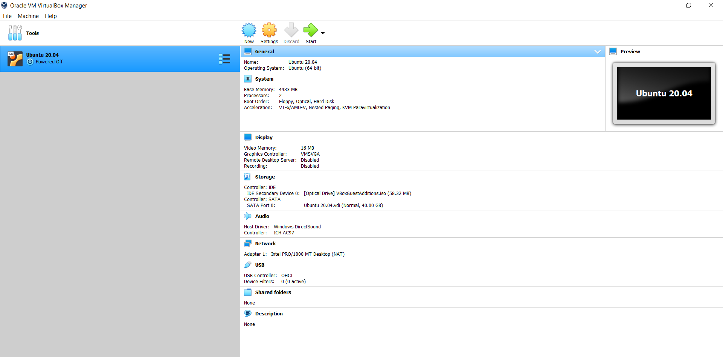
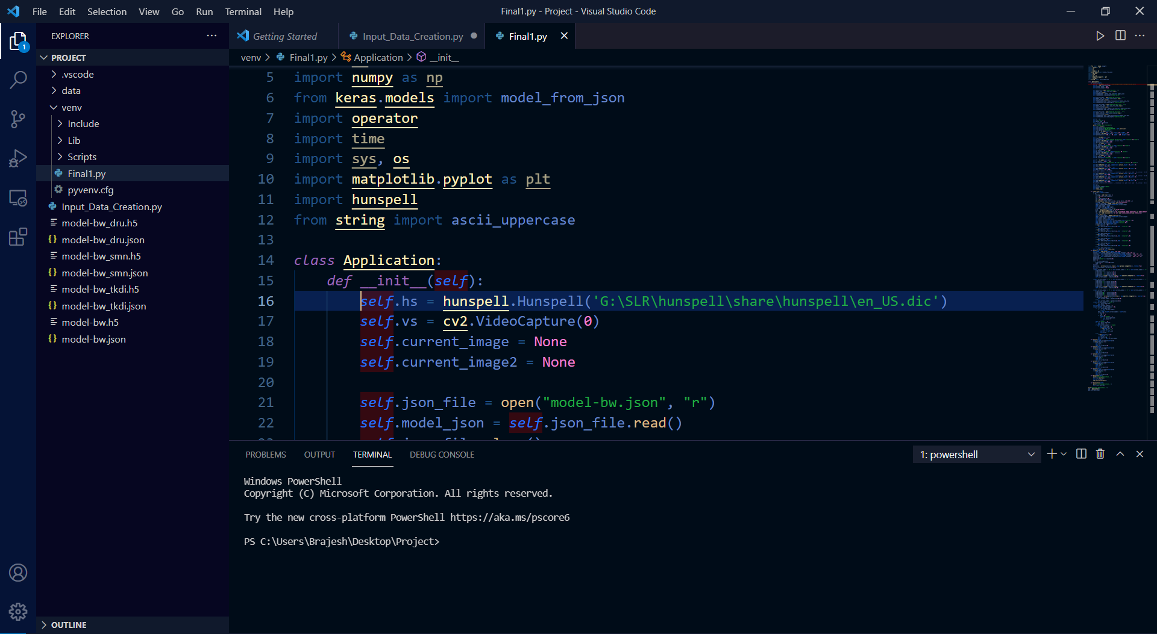
Figure: Oracle Virtual Box containing Ubuntu 20.04
Figure: Microsoft VS Code

Slide 8
Project Break-up
Input Data Creation
Pre-processing
Model Training
Final Part &
Output

Slide 9
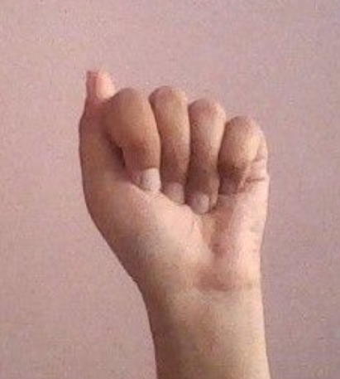
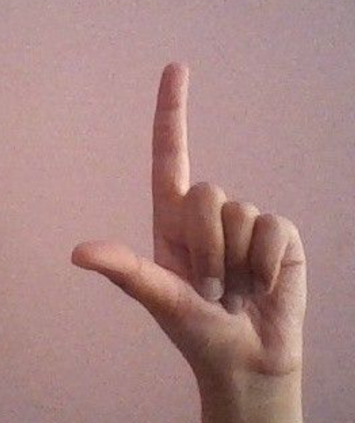
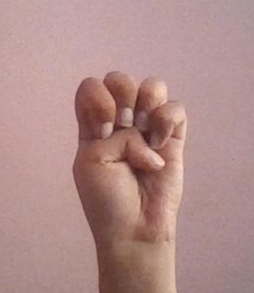
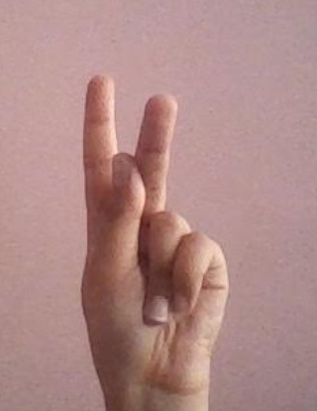
Input Data Creation
For input data, we set the counter for each of the alphabet of ASL. We accessed the system’s camera with the help of OpenCV library of the Python.
We defined the Region of Interest (ROI) whose dimension is kept 620 x 249. ROI is the area where user is supposed to make hand gestures.
We took the 800 images of each of the gesture of corresponding alphabets.
With each capture, counter increases and captured image get saved into the directory created with the help of OS module of Python.
Gesture for A
Gesture for L
Gesture for E
Gesture for K

Slide 10
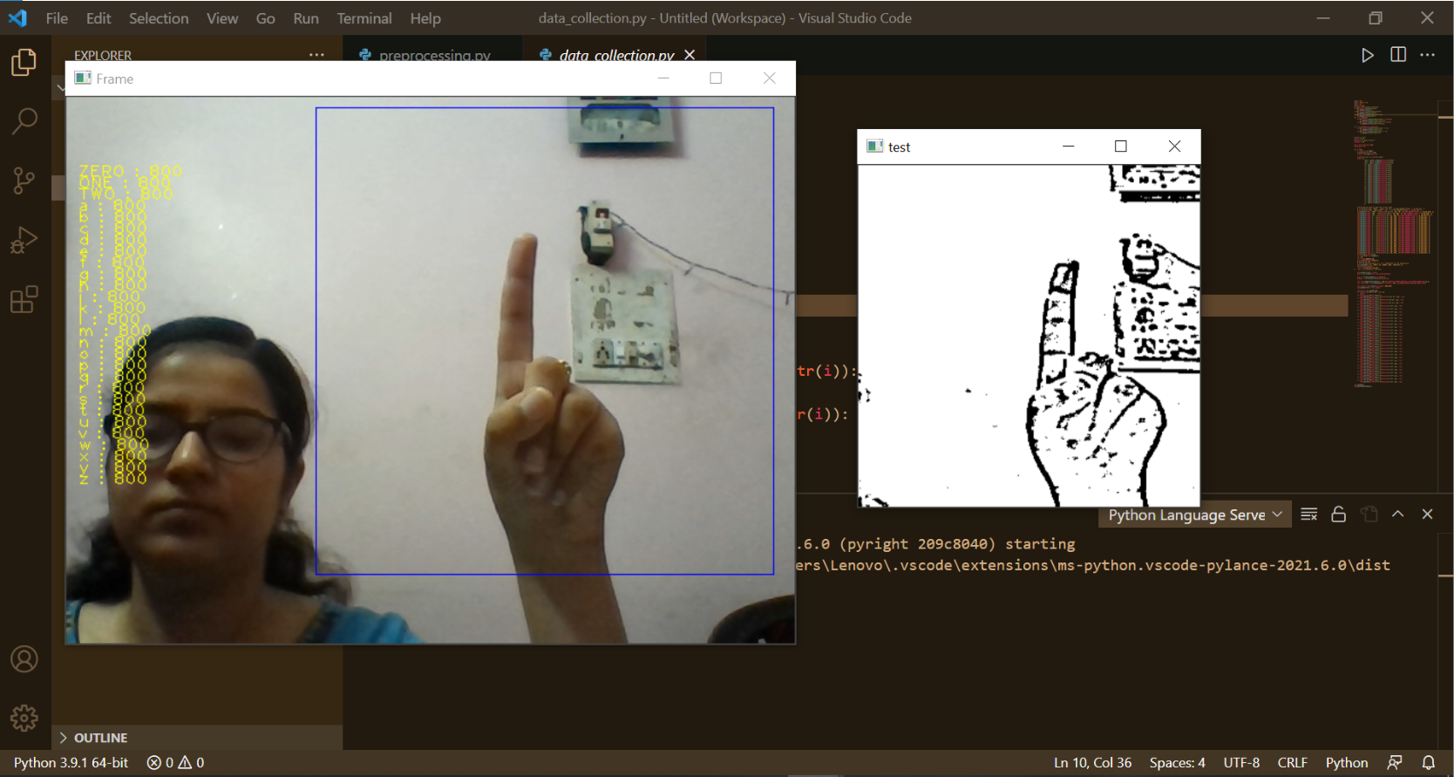

Slide 11
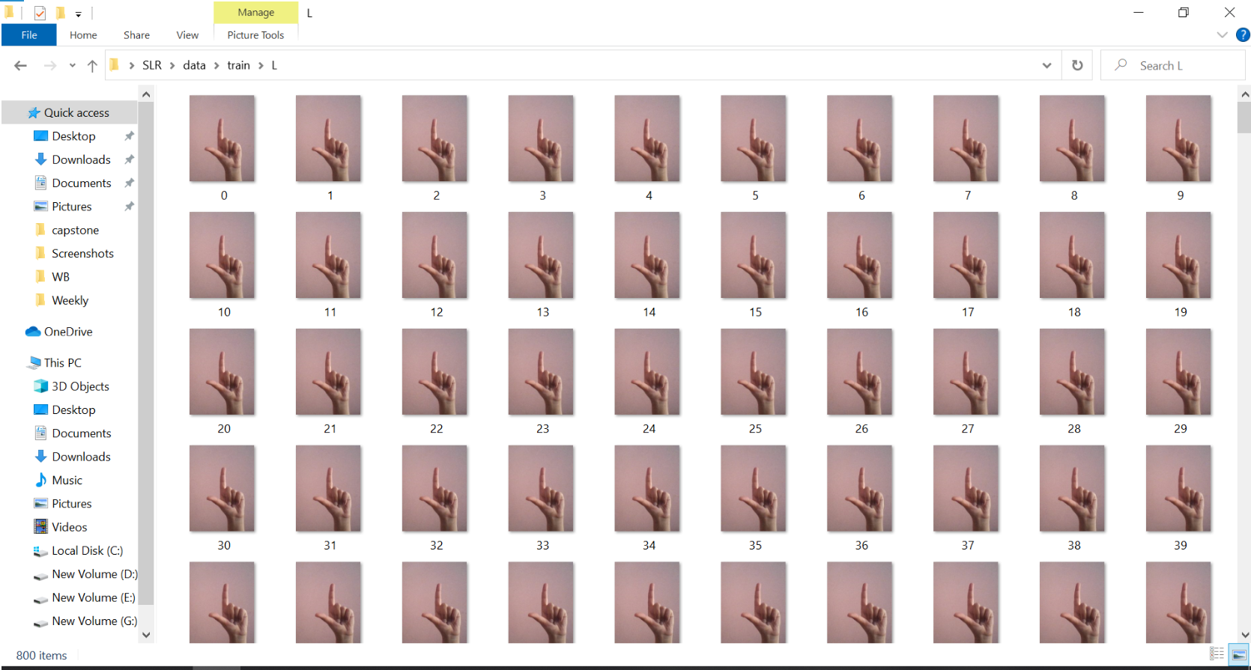

Slide 12
Pre-processing
After the creation of the dataset, there are lot of features in our images e.g. color of the image, background that are not required for the further processing. Moving forward with all these features can decrease the efficiency and accuracy of the model drastically.
For removal of colour of the images we converted all the images into grayscale images by applying Gaussian Blur filter so that background and hand portion could still be separable and visible.
Next comes the removal of background, for this a thresholding is required. Thresholding is the process to detect the boundaries or edges of any object (In our case, it is hand).
In OpenCV module, there are three types of thresholding techniques available: Simple Thresholding, Adaptive Thresholding and Otsu’s Binarization.

Slide 13
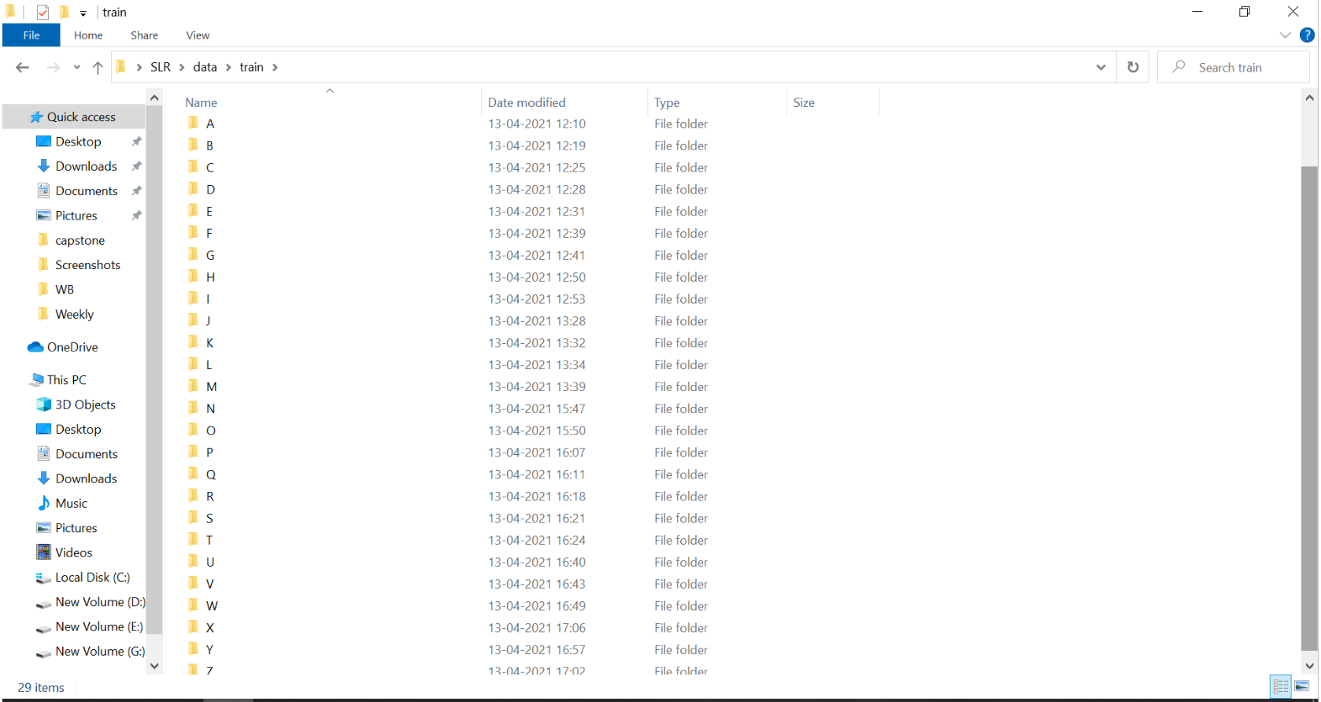

Slide 14
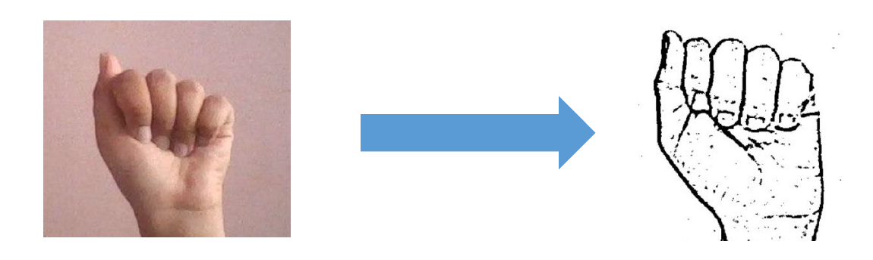
Pre-processing (Contd.)
In Adaptive Thresholding, system will itself analyse the pixels values of grayscale images and generates the graph called histogram and then it will take the average of all the maxima points present in the histogram and that average value will be returned as threshold value.
Pixels value above the threshold value is taken as hand portion and pixels value below that average value is considered as background and dropped from the image.
Figure: Output after Pre-processing

Slide 15
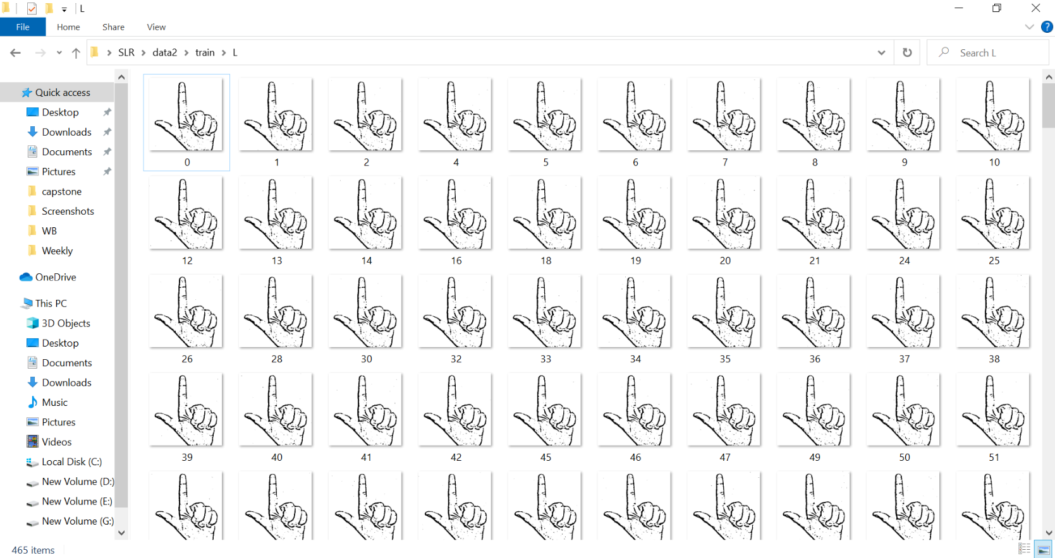

Slide 16
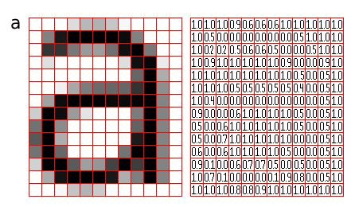

About Convolutional Neural Network (CNN)
Computers can not see things as we do, for computers image is nothing but a matrix.
In CNN, we take an image matrix as an input, assign importance to its various aspects/features in the image and be able to differentiate one from another.
Figure: Image in the form of matrix
Figure: CNN

Slide 17


Important Terminologies related to CNN
Convolution Layer performs a dot product between two matrices, where one matrix(known as filter/kernel)is the set of learnable parameters, and the other matrix is the restricted portion of the image.
At the end of the convolution process, we have a featured matrix which has lesser parameters(dimensions) than the actual image as well as more clear features than the actual one.
Pooling Layer is solely to decrease the computational power required to process the data. It is done by decreasing the dimensions of the featured matrix even more. In this layer, we try to extract the dominant features from a restricted amount of neighborhood.
Working of Convolution Layer
Working of Pooling Layer

Slide 18
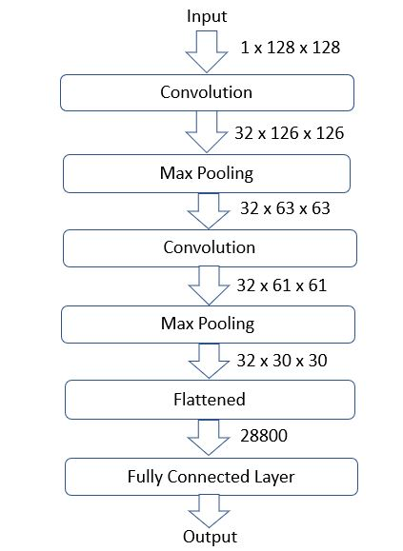
Model Training (CNN Architecture)
Figure: Layer-1 CNN Architecture

Slide 19
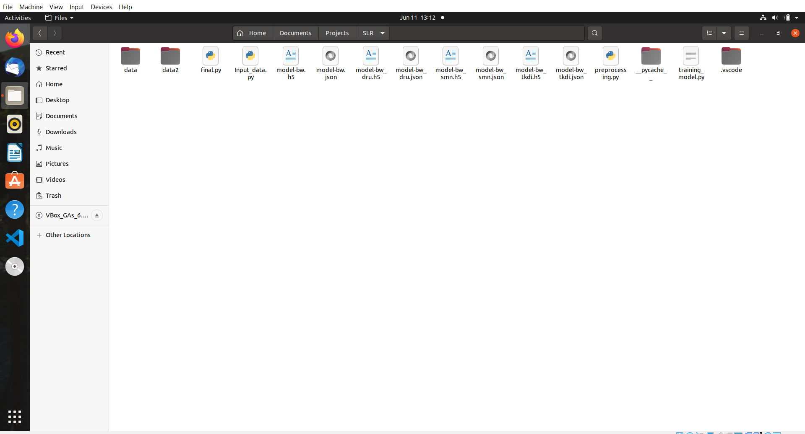
Models Created and Saved

Slide 20
Project Output

Slide 21
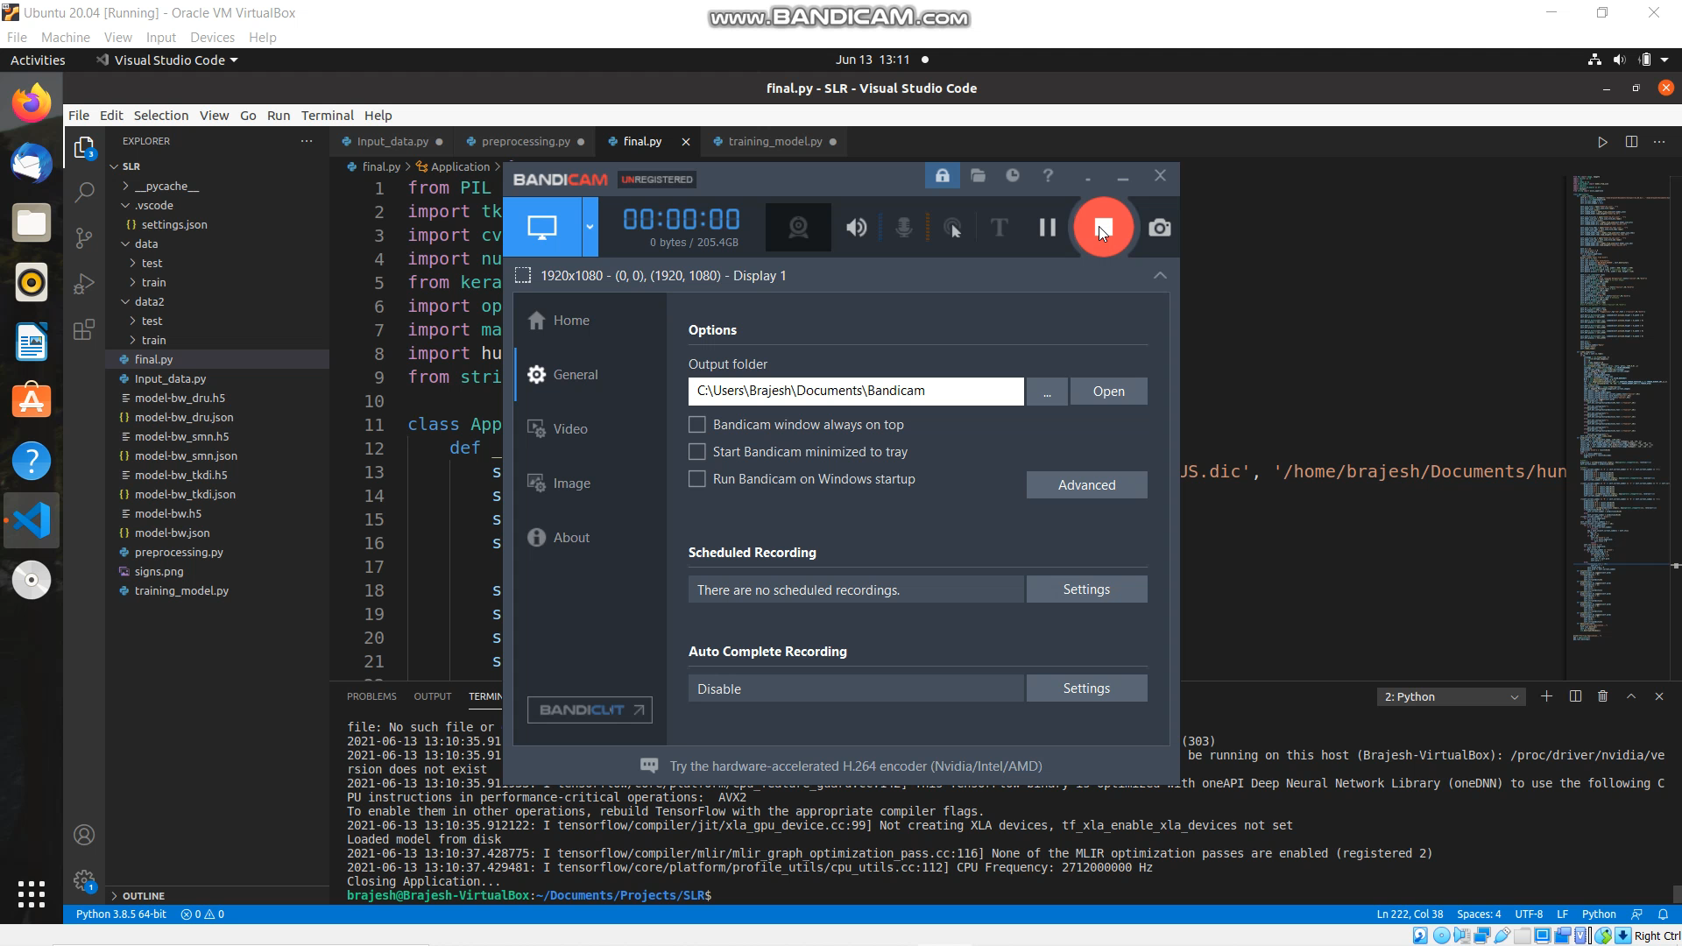

Slide 22
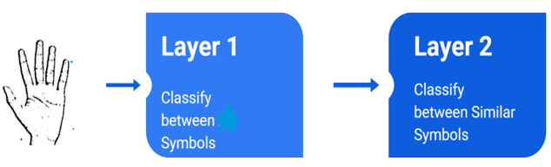
Results and discussions
The processed image input is first sent to the Layer 1 CNN model, which yielded the same results for a particular set of symbols:
For D: U,R ; For U: R,D; For T: I,K,D; For S: N,M
For these set of symbols, we specifically trained separate models. Firstly Layer 1 model will classify among 26 symbols, if output of Layer-1 falls into any one of these category then that output will be passed through Layer-2.
Figure: Classification between similar type of symbols at Layer 2

Slide 23
Challenges Faced and Limitations
Initially, a dataset containing raw images of all ASL characters was to be compiled, however, no fitting dataset could be identified in the public dataset repositories like Kaggle, UCI Machine Learning Repository. As a result, we created our own dataset and performed all the necessary preprocessing operations.
The next issue was to choose the filter for feature extraction. Various filters, such as gaussian blur, binary threshold, canny edge detection, and others, were tested, with the gaussian blur filter proving to be the most efficient.
Aside from that, there were problems with the model's accuracy due to lighting conditions; the model does not have promising accuracy when lighting conditions were poor.

Slide 24
Future Scope
From the various studies, we found that there is no universal sign language. Therefore, when a deaf or speech-impaired person travels to another country or region, he/she might face the problem because the device in which SLR is integrated might not have the sign language of the region he/she belongs to.
Therefore, further studies should be concerned about integrating all the sign languages used across the globe into one device with a convenient and customizable user interface to make it more robust and barrier-breaker.
Deep Neural Network (DNN) can learn good features from multi-modal histogram because these histograms can enhance the accuracy of recognition by providing more knowledge or features about sign gestures

Slide 25
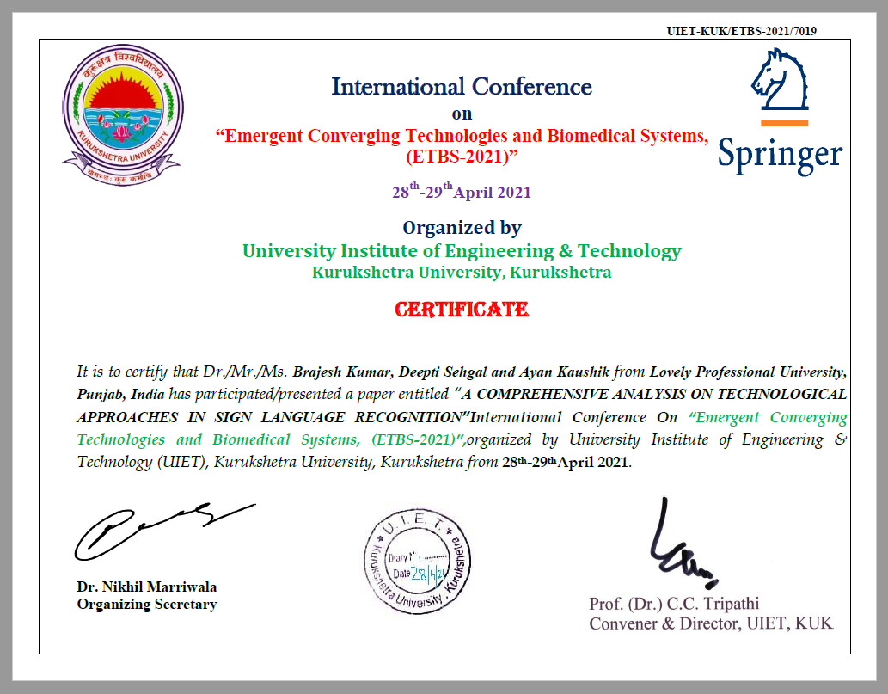
ETBS 2021
We successfully presented our paper at International Conference on Emergent Converging Technologies and Biomedical Systems (ETBS-2021), organised by UIET, Kurukshetra University, Haryana, India.
All the papers accepted and presented in this conference will be published by Springer in its popular book series Lecture Notes in Electrical Engineering (ISSN NO: 1876-1100).
The mentioned book series of Springer is indexed in Scopus and ESCI databases.

Slide 26
Conclusion
On the whole, this project recognize and predicts the meaning of American Sign Language (ASL) gestures along with the feature of suggestions.
Experts in different disciplines have primarily performed past studies on sign language comprehension for numerous sign languages, reducing real-world utility.
Our project only use the system’s camera as hardware utility, therefore no matter of cost.
Conclusively, everyone is of value in society and has the right to communicate with others regardless of their physical impairments.

Slide 27
Thank You!

